Slide 1
COMP-7150 Natural Language Processing Instructor: Salim Sazzed Department of Computer Science University of Memphis

Slide 2
Recap

Slide 3
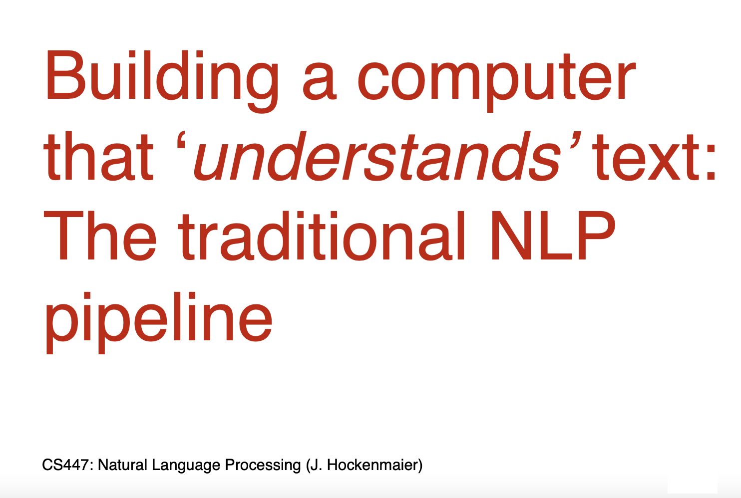
What could be some challenges?

Slide 4
Tokenization
Tokenization: Process of converting a sequence of text into smaller parts, known as tokens.
Needed for search engines, machine translation, etc.
Let's consider the sentence, "Chatbots are helpful”
Simple and obvious way is to use Space character-
["Chatbots", "are", "helpful"].

Slide 5
Wait! , not so simple…..
What about the following sentence-
“There was an earthquake near D.C. You could even feel it in Philadelphia, New York, etc. “
What we will get-
[There’, ‘was’, ‘an’, ‘earthquake’, ‘near’, ‘D.C.’, You’, ‘could’, ‘even’, ‘feel’, ‘it’, ‘in’ ‘Philadelphia,’ , ‘New’, ‘York,’ , ‘etc.’ ]
What we want-
[There’, ‘was’, ‘an’, ‘earthquake’, ‘near’, ‘D.C.’, You could even feel it in ‘Philadelphia’ , ‘New York’ , ‘etc’ ]

Slide 6
Ambiguity
Language is inherently ambiguous. Consider the sentence "Flying planes can be dangerous."
Depending on how it's tokenized and interpreted, it could mean that the act of piloting planes is risky or that planes in flight pose a danger. Such ambiguities can lead to vastly different interpretations.
https://www.datacamp.com/blog/what-is-tokenization#:~:text=Here%27s%20a%20deeper%20dive%20into%20some%20of%20these,Texts%20often%20contain%20more%20than%20just%20words.%20

Slide 7
Structural Ambiguity:
Structural ambiguity, also known as syntactic ambiguity, occurs when the structure or syntax of a sentence allows for multiple interpretations or meanings.
This ambiguity arises from the way words and phrases are arranged in a sentence, leading to more than one possible parse or understanding.

Slide 8
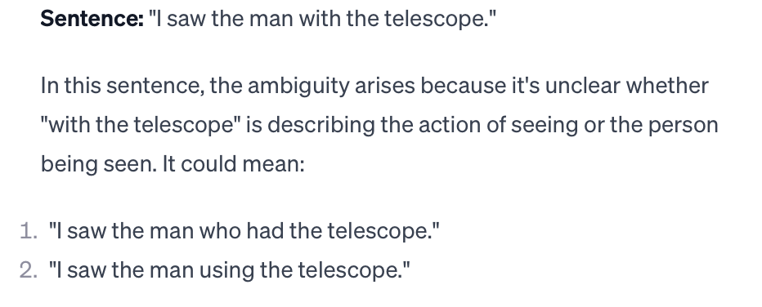
Example:

Slide 9
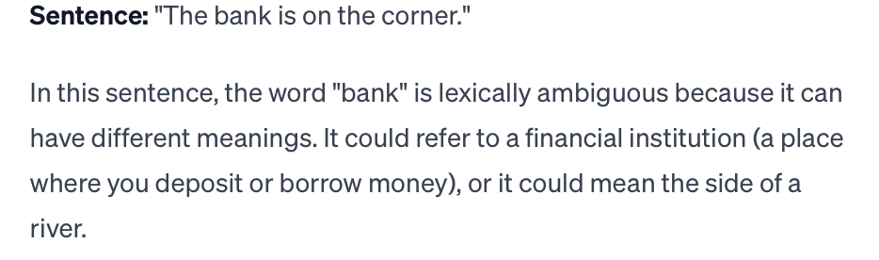
Lexical Ambiguity:
Lexical ambiguity occurs when a word or phrase has multiple meanings, and it's unclear which specific meaning is intended in a particular context.
Unlike structural ambiguity, which is related to the sentence structure and how words are arranged, lexical ambiguity is associated with the inherent multiple meanings of individual words or expressions.

Slide 10
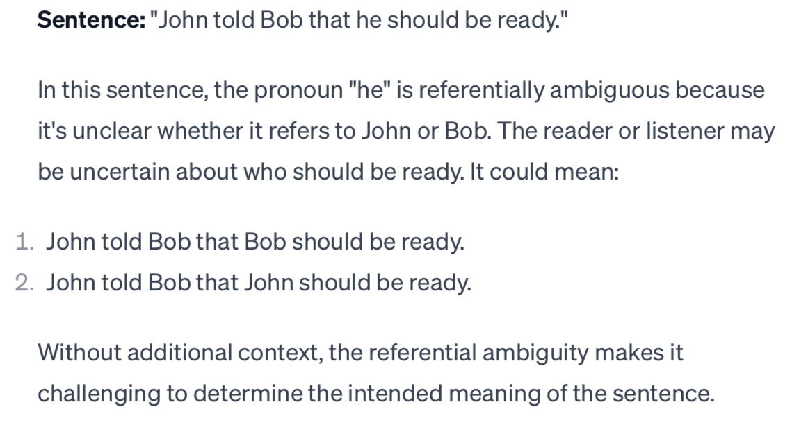
Referential Ambiguity
Referential ambiguity occurs when it is unclear to whom or what a pronoun or a reference in a sentence is pointing.

Slide 11
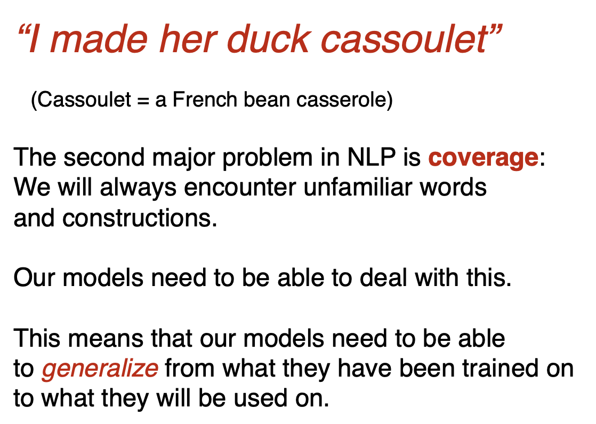
Coverage:

Slide 12
Task: Part-of-speech tagging
Assigning a specific part of speech (such as noun, verb, adjective, adverb, etc.) to each word in a given text.
POS tagging is an essential step in many NLP applications, including machine translation, information retrieval, and text-to-speech synthesis.
For example, consider the sentence: "The cat is sitting on the mat.”
"The" - Article (DET)
"cat" - Noun (N)
"is" - Verb (V)
"sitting" - Verb (V)
"on" - Preposition (P)
"the" - Article (DET)
"mat" - Noun (N)

Slide 13
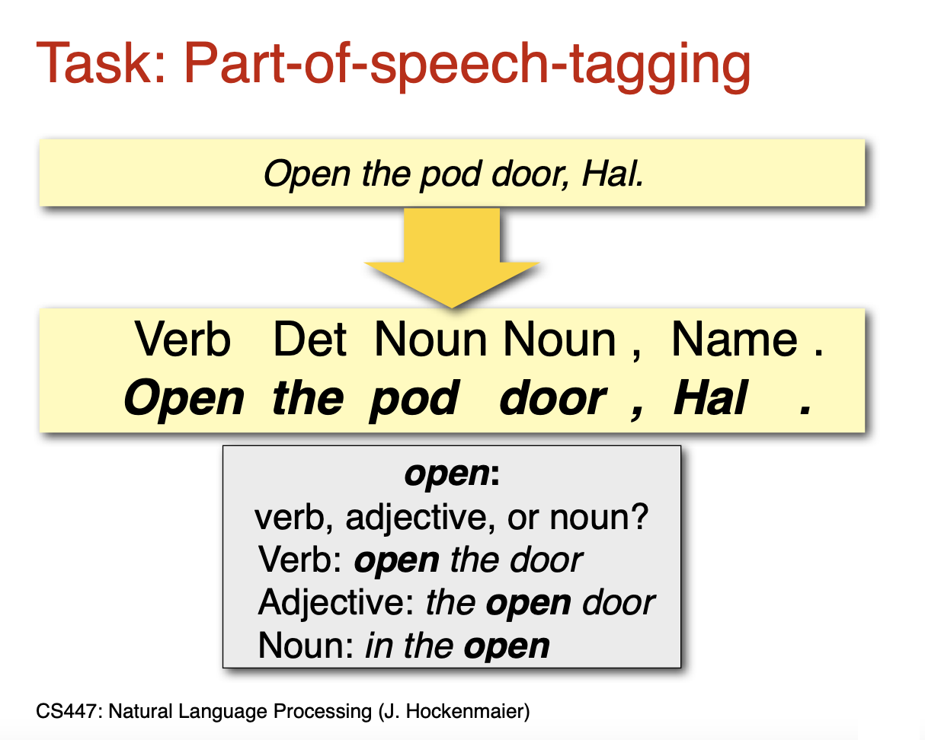
Wait! , not so simple…..

Slide 14
Main Components of a Language
Phonetics and phonology | The study of language sounds
Morphology | The study of meaningful components of words
Syntax | The study of structural relationships among words
Lexical and sentential semantics | The study of word meaning/meaning of sentences
Pragmatics | The study of the use of language to accomplish goals
Discourse conventions | The study of conventions of dialogue

Slide 15
Phonetics and Phonology
Phonetics: The study of the physical sounds of human speech, including the articulation and acoustic properties of speech sounds.
It involves the analysis and classification of the sounds produced by the vocal organs, such as the lips, tongue, vocal cords, and respiratory system.
Articulatory Phonetics: movements of the tongue, lips, vocal cords, and other speech organs.
Acoustic Phonetics: Frequency, amplitude, and duration of speech sound
Auditory Phonetics: Concerned with how humans perceive and process speech sounds

Slide 16
Morphology
Morphology: The study of the structure and formation of words. It involves the analysis of morphemes, the smallest units of meaning.

Slide 17
Syntax
The study of sentence structure and the rules governing the combination of words to form grammatical sentences.
How words are combined to form grammatically correct and meaningful units, such as sentences and phrases.

Slide 18
Semantics
The branch of linguistics that deals with the meaning of words, phrases, and sentences.
Key aspects include:
Words Meaning
Sentence Meaning

Slide 19
Pragmatics
The study of how context/situation influences the interpretation of language.
It involves understanding the use of language in social contexts and the implied meaning in communication.
Example: Performing actions (speech acts), such as making requests, giving orders, apologizing, or promising.
Pragmatics is crucial for interpreting language beyond its literal meaning and for navigating the complexities of social interaction.
focusing on how speakers use language in context to convey intended meanings and how listeners interpret those meanings.

Slide 20
Discourse
The study of larger units of language, such as conversations, narratives, and written texts.
It focuses on the organization and structure of extended stretches of language.

Slide 21
Example:
Person A: Hey, did you catch the game last night?
Person B: Yeah, I watched it. It was intense!
Person A: Right? I thought they played really well in the second half.
Person B: Absolutely. That last-minute goal was unbelievable.
A conversation between Person A and Person B constitutes a discourse.
It involves an exchange of information and opinions related to a shared topic, which is the recent sports game.
The discourse is characterized by turn-taking, where each person contributes to the conversation, and there is a shared understanding of the context (the sports game) and the language used (discussing the game's intensity and specific events).
Discourse can also include written texts, interviews, speeches, or any form of communication where language is used to convey meaning within a specific context.

Slide 22
Morphology

Slide 23
Morphology is the study of the way words are built from smaller meaningful units called morphemes.
We can divide morphemes into two broad classes:
Stem(s) – the core meaningful units, the root of the word.
Affix(es) – add additional meanings and grammatical functions to words.

Slide 24
A stem is the base or root form of a word to which affixes (prefixes, suffixes, or infixes) are added to derive different forms of the word.
The process of reducing a word to its base or root form is called stemming.
Here's a simple example to illustrate stemming:
Original words: "running," "runner," "ran"
Stemmed forms: "run"

Slide 25
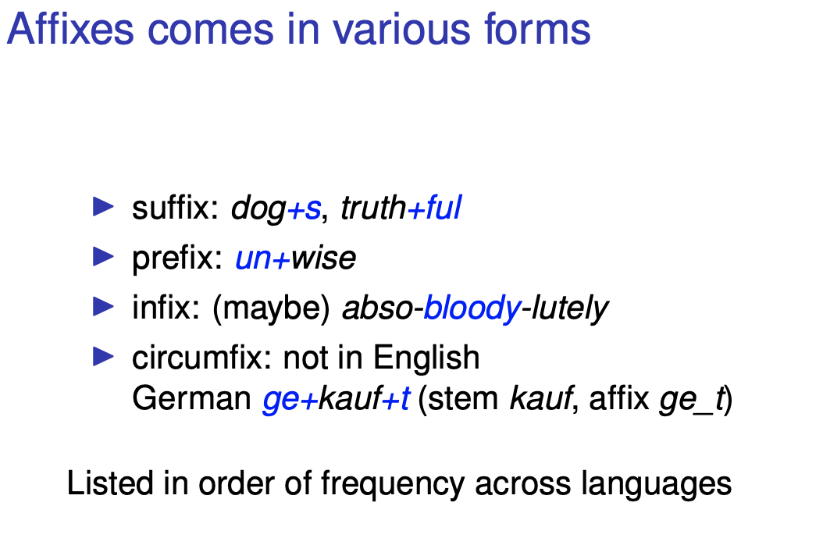

Slide 26
Inflectional and Derivational Morphology
There are two broad classes of morphology:
Inflectional morphology
Derivational morphology
After a combination with an inflectional morpheme, the meaning and class of the actual stem usually do not change.
eat / eats pencil / pencils
gel / geliyorum masa / masam
After a combination with a derivational morpheme, the meaning and the class of the actual stem usually change.
compute / computer do / undo friend / friendly
Uygar / uygarlaş kapı / kapıcı
The irregular changes may happen with derivational affixes.

Slide 27
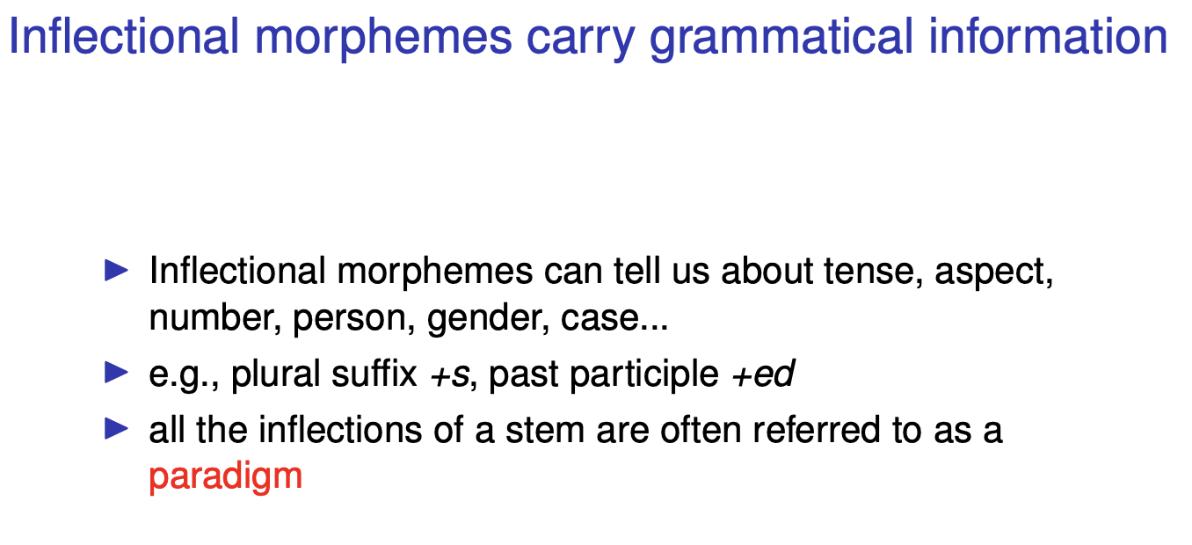

Slide 28
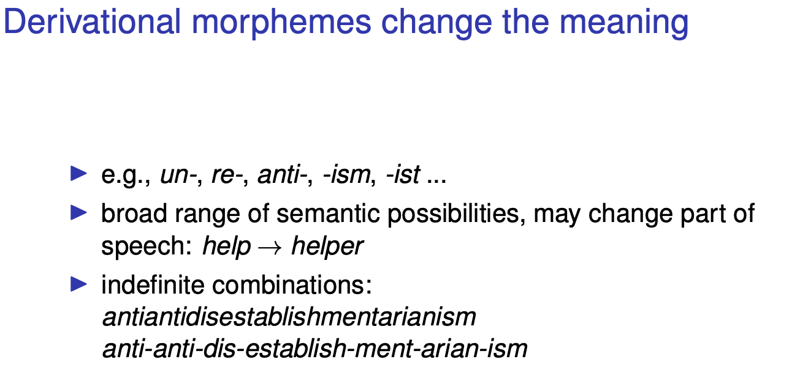

Slide 29
English Inflectional Morphology
Nouns have simple inflectional morphology.
plural -- cat / cats
possessive -- John / John’s
Verbs have slightly more complex inflectional, but still relatively simple inflectional morphology.
past form -- walk / walked
past participle form -- walk / walked
gerund -- walk / walking
singular third person -- walk / walks

Slide 30
English Derivational Morphology
Some English derivational affixes
-ation : transport / transportation
-er : kill / killer
-ness : fuzzy / fuzziness
-al : computation / computational
-able : break / breakable
-less : help / helpless
un : do / undo
re : try / retry

Slide 31
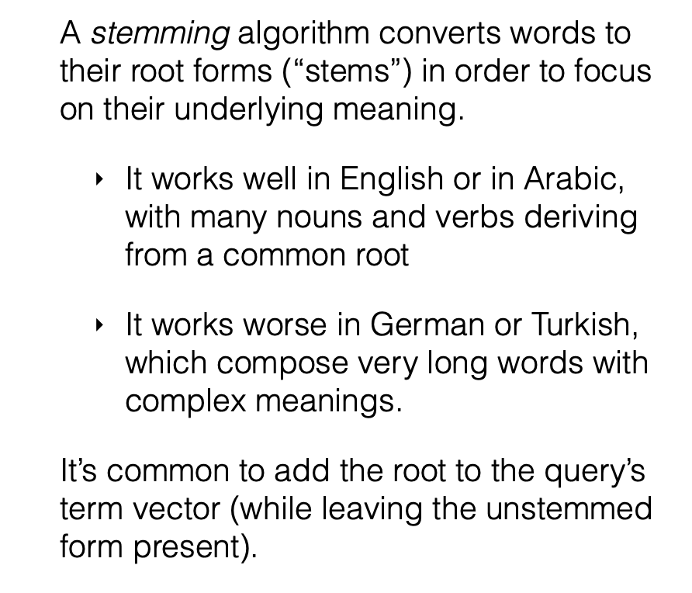
Stemming

Slide 32
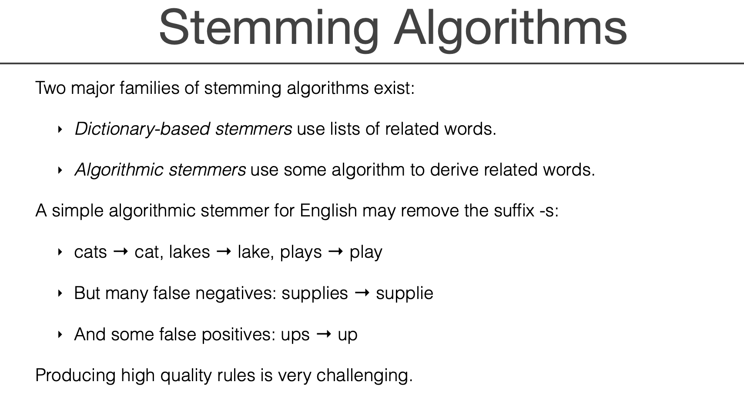

Slide 33
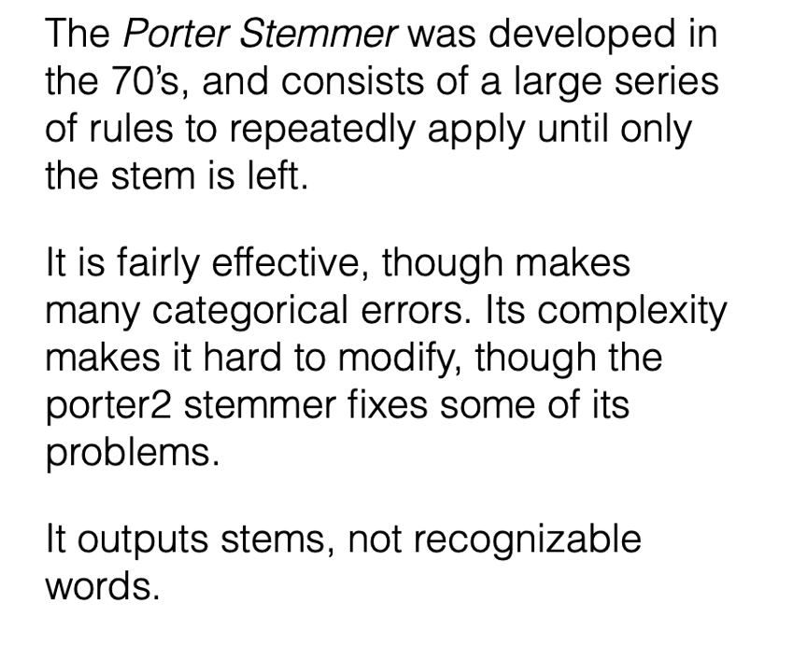
Porter Stemmer

Slide 34
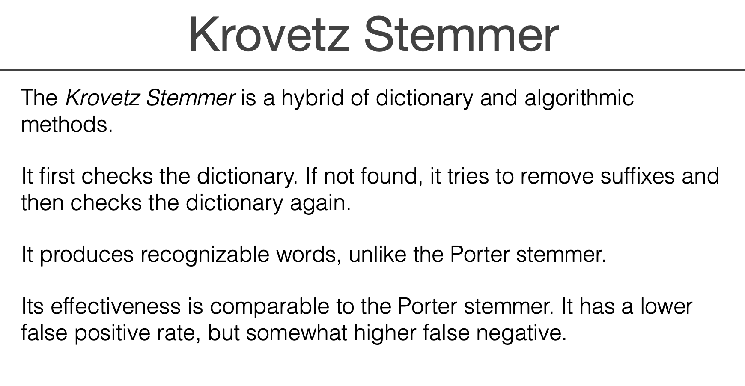

Slide 35
